Slide 1
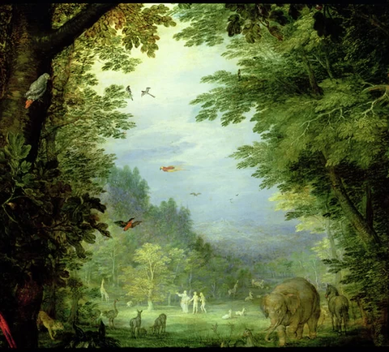
We pray
“In the name of the Father, and of the Son, and of the Holy Spirit”
“Father God, you formed us from the dust of the earth and placed us in a garden. Remind us of our place as your creatures at home in your creation. Forgive us when we forget our connection to the earth, and our dependence upon the goodness of your world. Lord have mercy ! Amen”
“In the name of the Father, and of the Son, and of the Holy Spirit”
Today in IB Design Technology: CHAPTER 2.

Slide 2
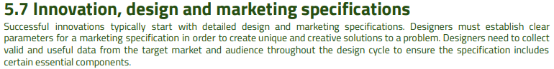
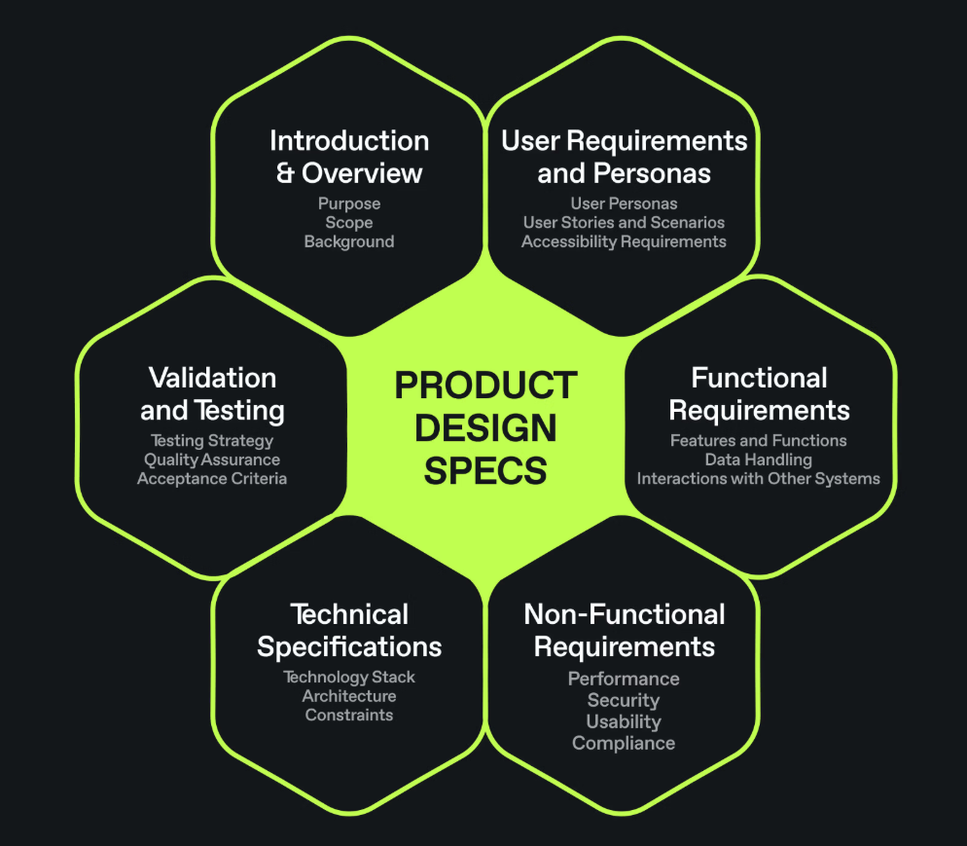
2.
Video:
Importance of Design Specifications

Slide 3
Design specifications
A design specification relates to the requirements of the actual product, and details aspects of:
Aesthetic requirements
How does the user want the product to look.
cost constraints
How cheaply does the product need to be made?
environmental requirements
What does the product have to do to be successful in its target environment.
size constraints
How big or small does it need to be?
safety considerations
What does the product need to do or avoid to ensure injuries don't happen.
Performance requirements and constraints
What does the user want the product to do?
materials requirements
What should the product be made from to be successful?
manufacturing requirements.
How should the product be made to meet the number require, and ensure a quality product
All of the requirements, constraints and considerations must be specific, feasible and measurable.
The design specification must be developed from the design brief and research.

Slide 4
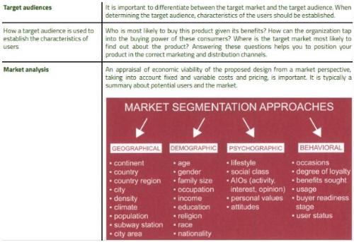
Video:
How to Define Your Target Market | 4 Types of Market Segmentation

Slide 5
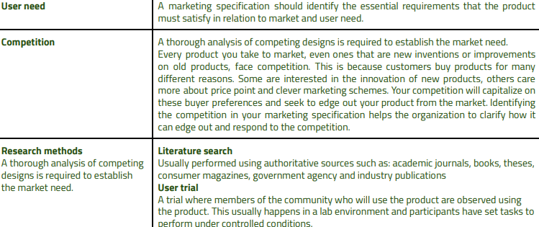
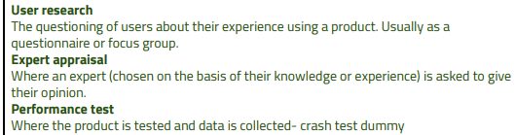
Video:
Creating a User Needs Statement in Design Thinking
Video:
7 Easy Steps on How to Perform a Competitor Analysis

Slide 6
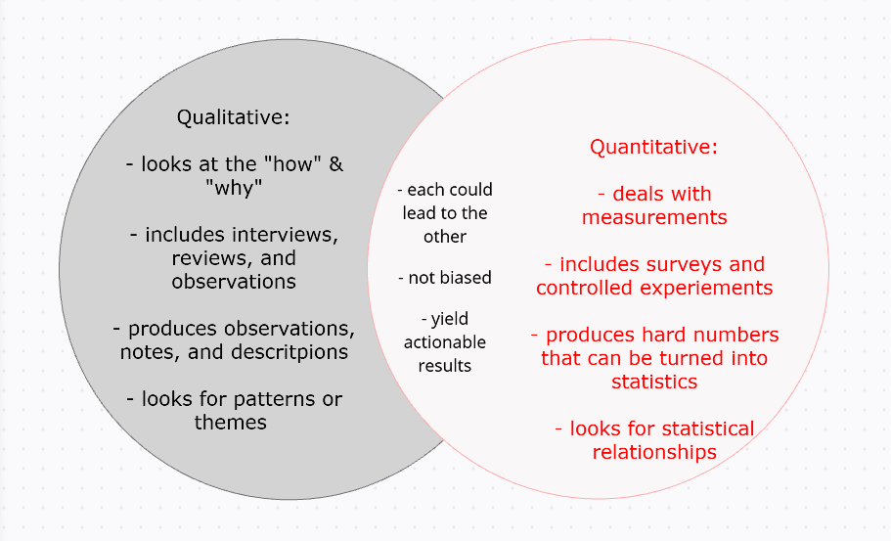
Design research is the practice of gaining insights by observing users and understanding industry and market shifts. It involves designers using ethnography to access study participants and gain the best insights for designing popular products and services
Ethnography is a qualitative research method focused on understanding people and cultures by immersing oneself in their environment and observing their behaviors and interactions.
Qualitative Research
Quantitative Research
Video:
Qualitative Research vs Quantitative Research: Understanding the Differences

Slide 7
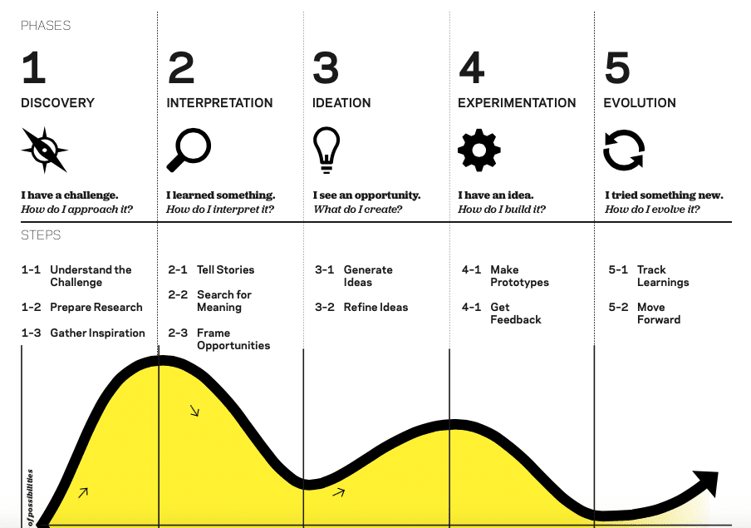
Design research in the context of IDEO, a company known for its design thinking approach, involves understanding users' needs, behaviors, and motivations through observation, interviews, and analysis to inform design decisions. Essentially, it's a human-centered approach to gathering insights that drive innovation and create solutions that truly meet user needs.
Video:
What is Design Thinking? | IDEO U

Slide 8

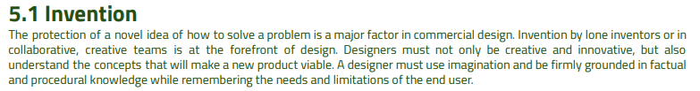
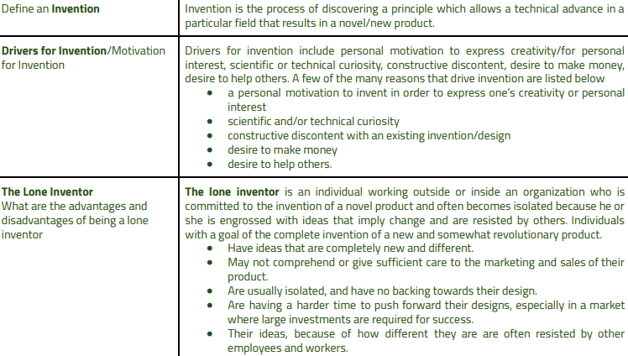
2.1
Video:
How inventions change history (for better and for worse) - Kenneth C. Davis

Slide 9
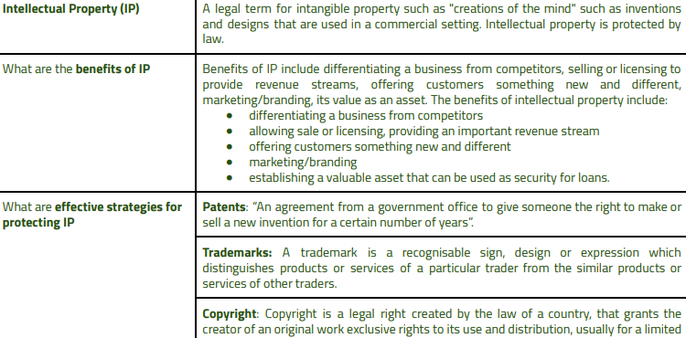
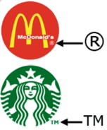
The circled R symbol (®) indicates that a trademark is registered with the United States Patent and Trademark Office (USPTO).
Video:
Understanding Intellectual Property (IP)

Slide 10
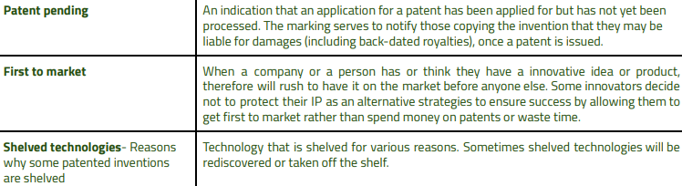
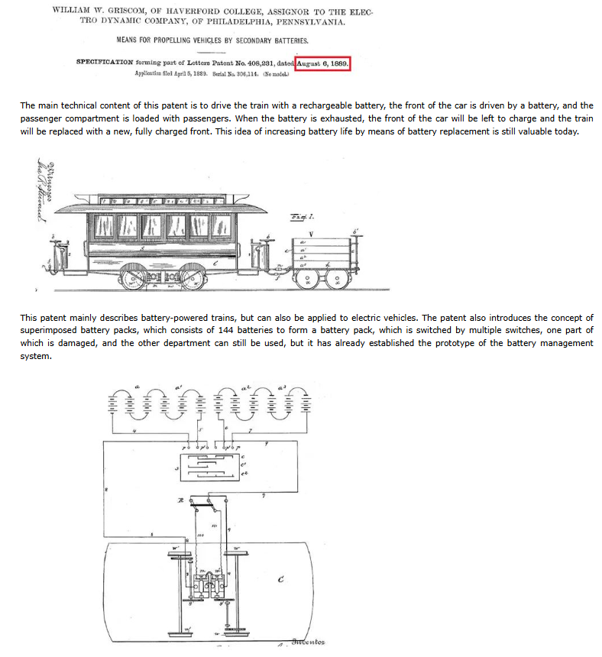
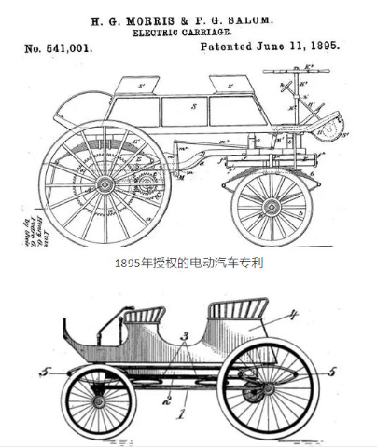

Slide 11
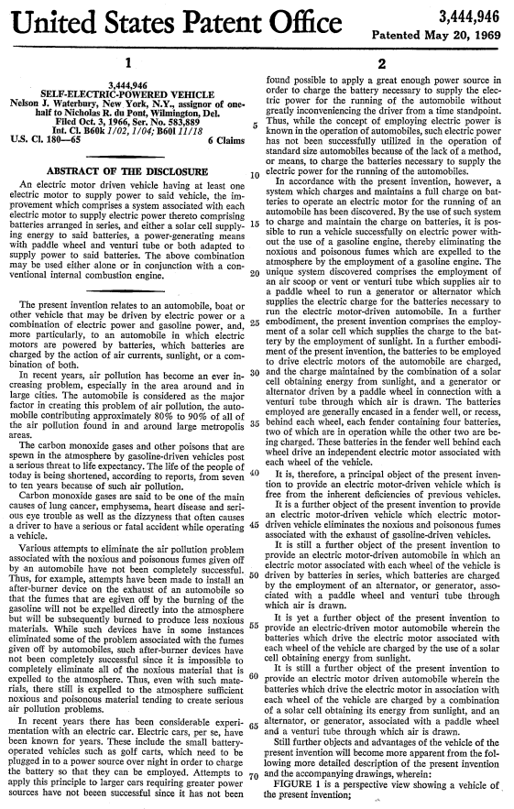
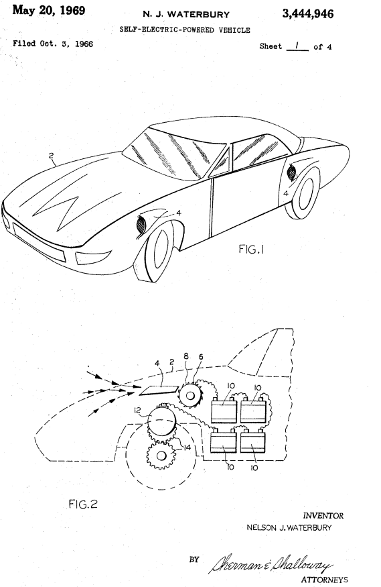
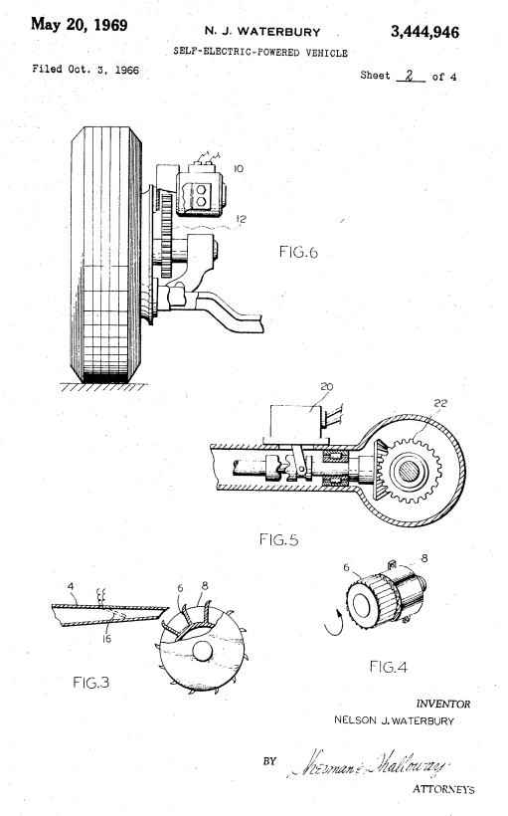
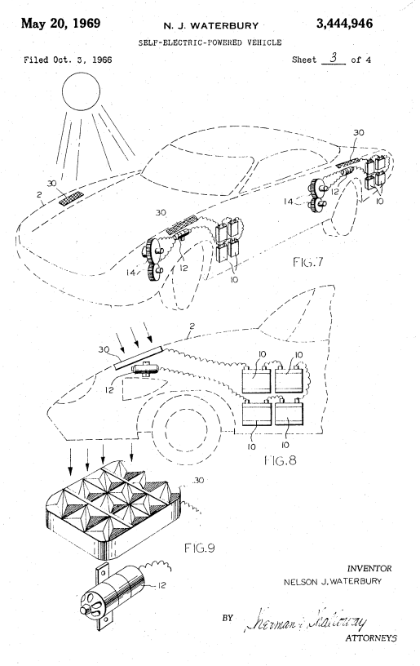

Slide 12
Video:
Write a Provisional Patent Application That Truly Has Value!
Video:
How I Brought My First Product to Market – Idea to Launch

Slide 13
We pray
“In the name of the Father, and of the Son, and of the Holy Spirit”
“Father God, you formed us from the dust of the earth and placed us in a garden. Remind us of our place as your creatures at home in your creation. Forgive us when we forget our connection to the earth, and our dependence upon the goodness of your world. Lord have mercy ! Amen”
“In the name of the Father, and of the Son, and of the Holy Spirit”
Today in IB Design Technology: CHAPTER 2.2

Slide 14
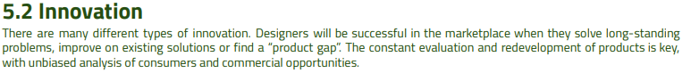
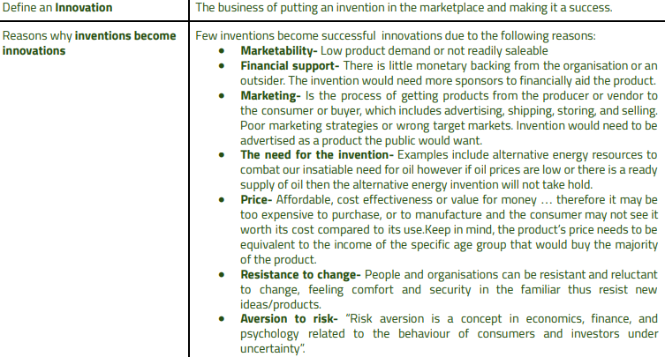
2.2
Video:
What's the difference between innovation & invention? | Tom Pullen | innovinco

Slide 15
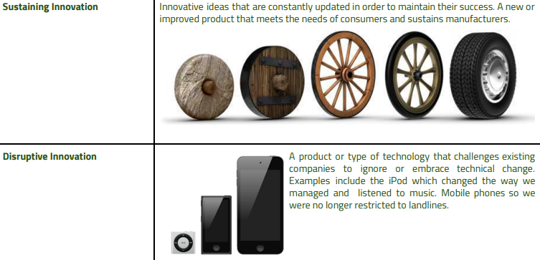
Video:
SOC February Simon Squibb 16x9

Slide 16
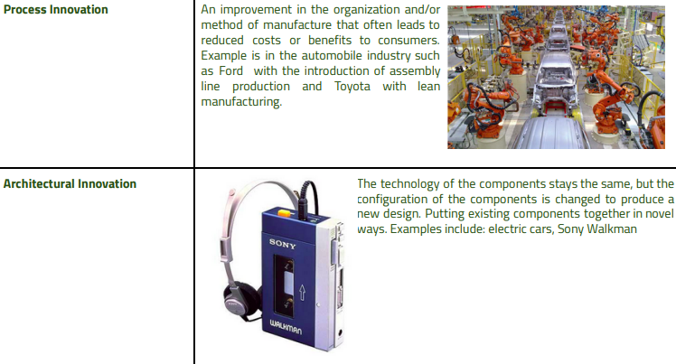

Slide 17
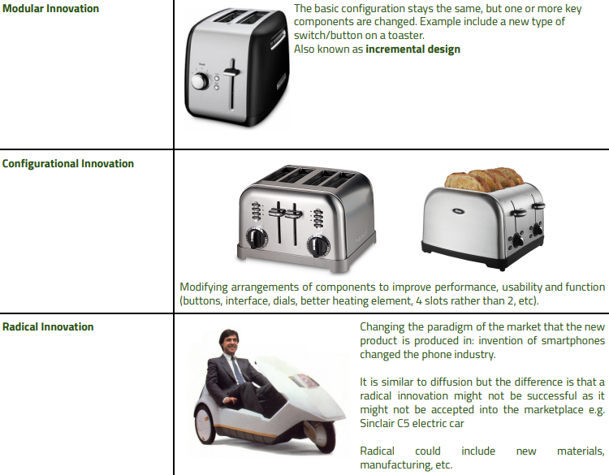

Slide 18
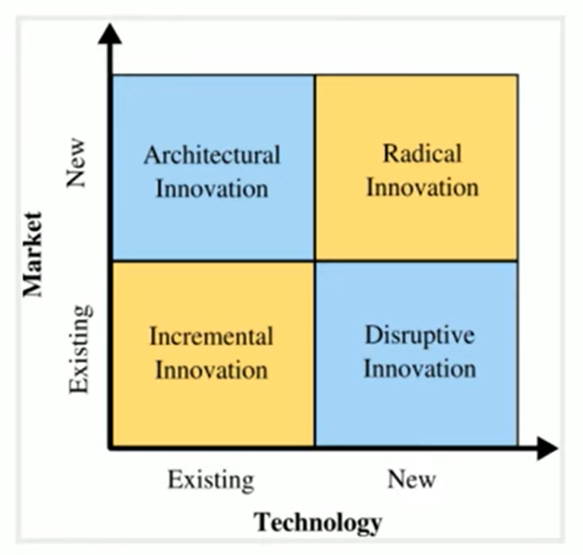
Video:
Innovation Matrix (Incremental, Disruptive, Architectural, Radical) | From A Business Professor

Slide 19
We pray
“In the name of the Father, and of the Son, and of the Holy Spirit”
“Father God, you formed us from the dust of the earth and placed us in a garden. Remind us of our place as your creatures at home in your creation. Forgive us when we forget our connection to the earth, and our dependence upon the goodness of your world. Lord have mercy ! Amen”
“In the name of the Father, and of the Son, and of the Holy Spirit”
Today in IB Design Technology: IA DESIGN PROJECT

Slide 20
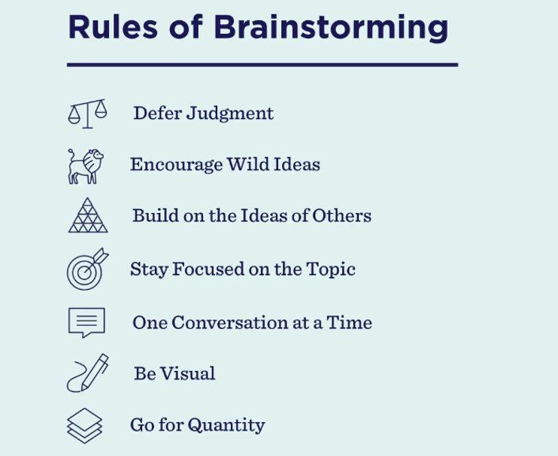
Video:
IDEO: Brainstorming and Other Ideation Techniques
7

Slide 21
We pray
“In the name of the Father, and of the Son, and of the Holy Spirit”
“Father God, you formed us from the dust of the earth and placed us in a garden. Remind us of our place as your creatures at home in your creation. Forgive us when we forget our connection to the earth, and our dependence upon the goodness of your world. Lord have mercy ! Amen”
“In the name of the Father, and of the Son, and of the Holy Spirit”
Today in IB Design Technology: CHAPTER 2.3/4

Slide 22
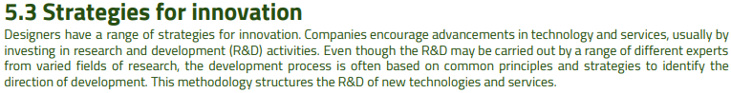
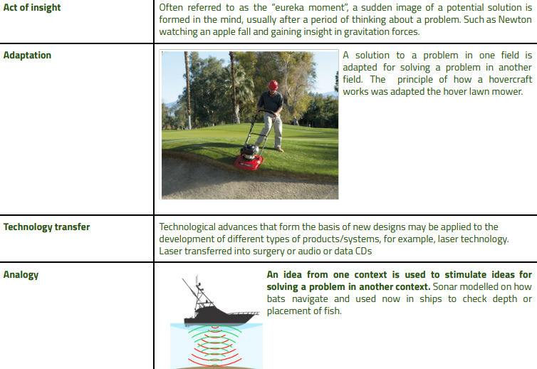
2.3
Video:
innovation strategies - Google Search
inspiration

Slide 23
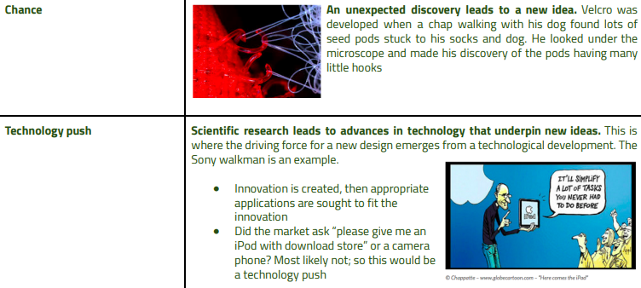
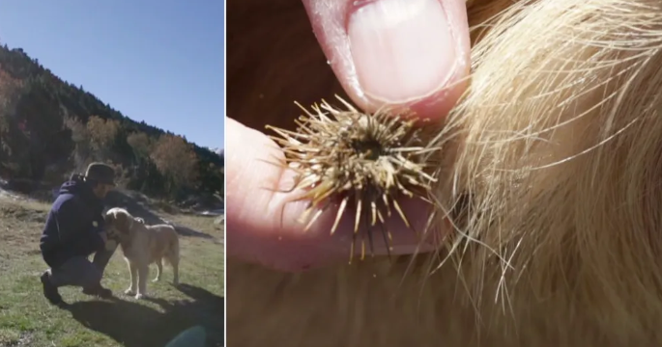
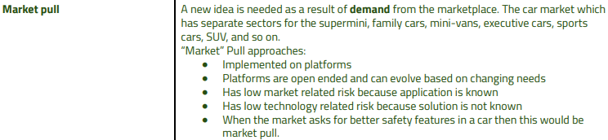
inspiration
Video:
TECHNOLOGY PUSH AND MARKET PULL INNOVATION // GCSE DESIGN AND TECHNOLOGY REVISION
inspiration

Slide 24
We pray
“In the name of the Father, and of the Son, and of the Holy Spirit”
“Father God, you formed us from the dust of the earth and placed us in a garden. Remind us of our place as your creatures at home in your creation. Forgive us when we forget our connection to the earth, and our dependence upon the goodness of your world. Lord have mercy ! Amen”
“In the name of the Father, and of the Son, and of the Holy Spirit”
Today in IB Design Technology: Prep CHAPTER 2.1-2.3

Slide 25
We pray
“In the name of the Father, and of the Son, and of the Holy Spirit”
“Father God, you formed us from the dust of the earth and placed us in a garden. Remind us of our place as your creatures at home in your creation. Forgive us when we forget our connection to the earth, and our dependence upon the goodness of your world. Lord have mercy ! Amen”
“In the name of the Father, and of the Son, and of the Holy Spirit”
Today in IB Design Technology: QUIZ CHAPTER 2.1-2.3

Slide 26
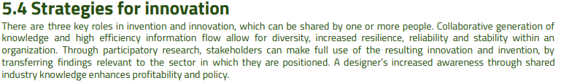
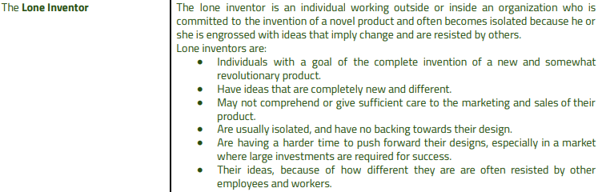
2.4 Strategies for innovators
Video:
The Difference Between Inventors and Innovators

Slide 27
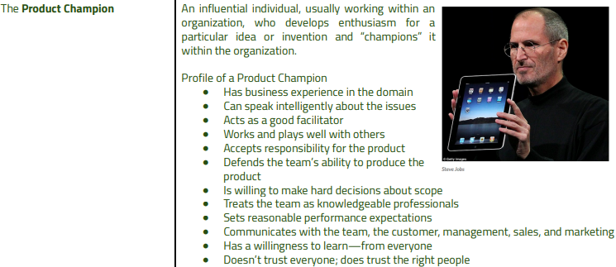
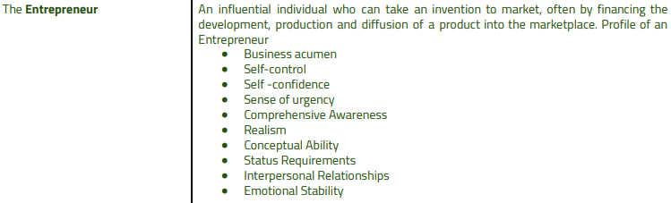
Video:
Steve Jobs explains the difference between a great idea and a great product
Video:
10 Characteristics of Successful Entrepreneurs | Business: Explained

Slide 28
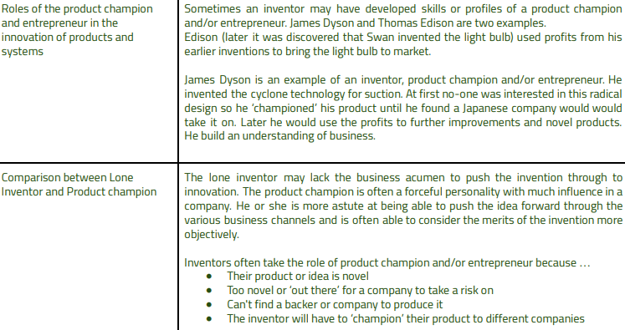
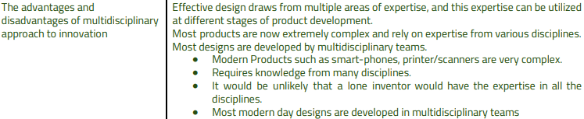

Slide 29
We pray
“In the name of the Father, and of the Son, and of the Holy Spirit”
“Father God, you formed us from the dust of the earth and placed us in a garden. Remind us of our place as your creatures at home in your creation. Forgive us when we forget our connection to the earth, and our dependence upon the goodness of your world. Lord have mercy ! Amen”
“In the name of the Father, and of the Son, and of the Holy Spirit”
Today in IB Design Technology: CHAPTER 2.5/6

Slide 30
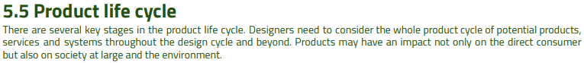
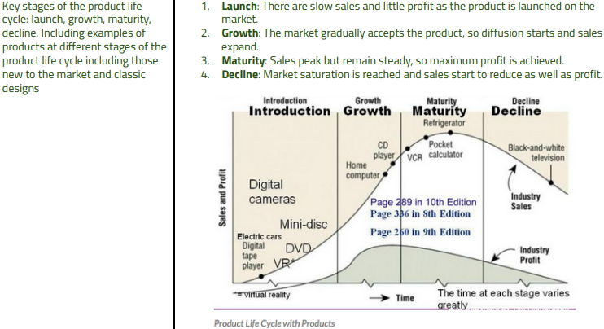
2.5
Video:
Product Life Cycle (With Real World Examples) | Strategic Management | From A Business Professor

Slide 31
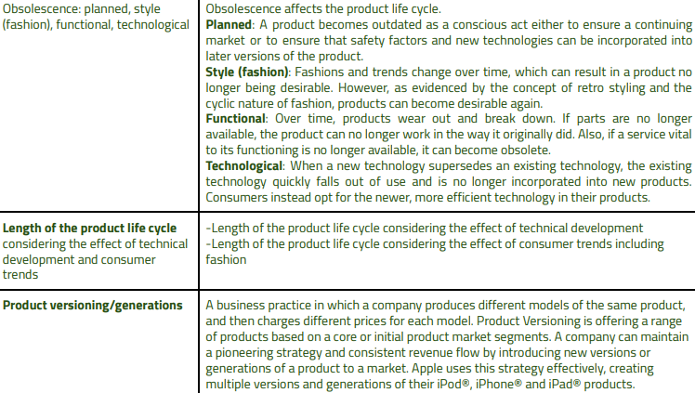
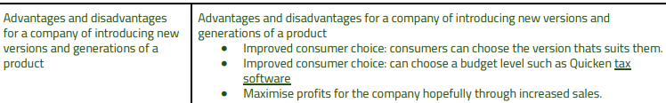
Video:
Planned Obsolescence | How Companies Trick You Into Buying More | Planned Obsolescence Documentary - YouTube

Slide 32
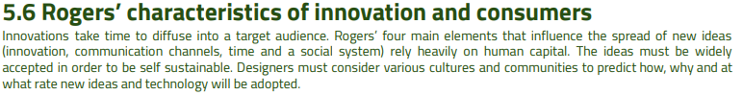
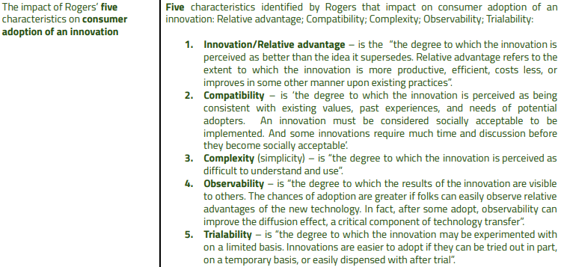
2.6
Video:
What are the factors that affect adoption?

Slide 33
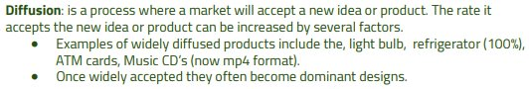
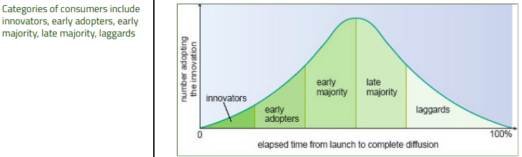
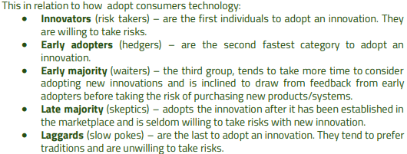
Stages of Innovation Diffusion
Video:
Diffusion of Innovation Theory: The Adoption Curve

Slide 34
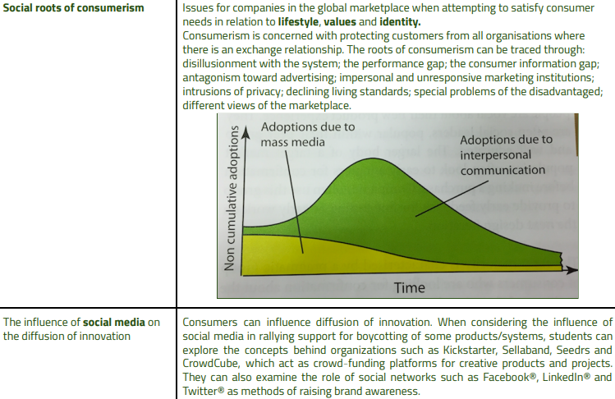

Slide 35
We pray
“In the name of the Father, and of the Son, and of the Holy Spirit”
“Father God, you formed us from the dust of the earth and placed us in a garden. Remind us of our place as your creatures at home in your creation. Forgive us when we forget our connection to the earth, and our dependence upon the goodness of your world. Lord have mercy ! Amen”
“In the name of the Father, and of the Son, and of the Holy Spirit”
Today in IB Design Technology: Prep TEST CHAPTER 2

Slide 36
We pray
“In the name of the Father, and of the Son, and of the Holy Spirit”
“Father God, you formed us from the dust of the earth and placed us in a garden. Remind us of our place as your creatures at home in your creation. Forgive us when we forget our connection to the earth, and our dependence upon the goodness of your world. Lord have mercy ! Amen”
“In the name of the Father, and of the Son, and of the Holy Spirit”
Today in IB Design Technology: TEST CHAPTER 2

Slide 37
We pray
“In the name of the Father, and of the Son, and of the Holy Spirit”
“Father God, you formed us from the dust of the earth and placed us in a garden. Remind us of our place as your creatures at home in your creation. Forgive us when we forget our connection to the earth, and our dependence upon the goodness of your world. Lord have mercy ! Amen”
“In the name of the Father, and of the Son, and of the Holy Spirit”
Today in IB Design Technology: Brainstorms

Slide 38
Video:
IDEO: Brainstorming and Other Ideation Techniques
7

